Slide 1
SIMULATION AND IMPLEMENTATION OF VARIABLE POWER SUPPLY presented by salihu abdullahi st/phy/hnd/21/001 A PROJECT SUBMITTED to the department of applied physics, federal polytechnic, mubi supervised by mr. sabo tantaso OCTOBER, 2023

Slide 2
INTRODUCTION
Development in the field of electronic have provided different technological approach used for upgrading and improving the standard DC voltages, communication instrumentation control etc. electronics perhaps more than any other field of technology, has enjoyed an explosive development. Generally, In electronics all electrical instrument and circuit require a source of direct current (DC) power before they operates, it Is either from a battery or a AC source (Hoftman, 2013).
According to Theraja and Theraja (2008) opines that most of electronic devices ad circuit require a d.c source for their operation. Dry cells and battery are one form of d.c source. Those type of dc source voltages are low; they need frequent replacement and are expensive as compared to conventional d.c. power supply (Adeite & Osemelikilali, 1996).

Slide 3
AIM OF THE STUDY
The aim is to simulated and implement a triple power supply to provide the required power load using an A.C. supply at the input and to obtain variable regulated power from 1 to 40 volt at the output terminal and display the value on screen by turning the potentiometer.

Slide 4
SPECIFIC OBJECTIVES
To put into practice the theoretical aspect of electronic told in class to solve problems.
To provide an electronic device that serve more than one purpose.
To eradicate frequency use of multimeter in measuring output voltage
To provide a device that can be used in various types of application.

Slide 5
SIGNIFICANCE OF THE STUDY
This project if completed will make it possible for researchers to have power supply to run different devices of higher or low value.
The project does not require any external measuring device such as multimeter and others because the quantity obtained is being displayed on the screen.
The project can be used in basic electricity laboratory and other laboratory where different D.C. voltage is required for practical.
The project can be used in electronic workshop by technician for repairs and maintenance of electronic devices.

Slide 6
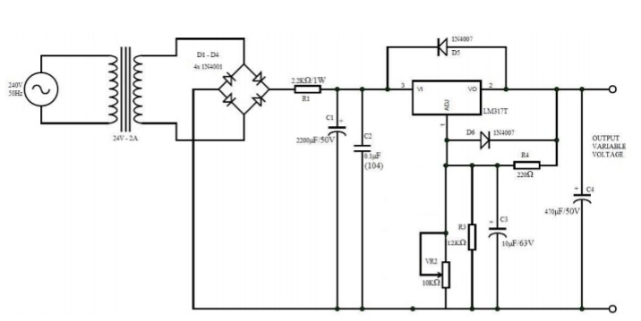
CIRCUIT DIAGRAM

Slide 7
RESULT
The result obtained during the test is stated at the table below:
S/N | TEST | RESULT | COMMENT
1 | A.C. Main input to transformer | 220volt A.C. | Input to transformer
2 | Rectifier input | 14volt A.C. | Transformer output to rectification
3 | Rectifier output | 22volt D.C. | Rectification output to the terminal of capacitor C1
4 | Variable D.C. voltage 1 to 40 | 1 to 42 | D.C. variable at the output terminal
5 | Vout Max | 40.25 | At the output terminal
6 | Vout Min | 1 | At the output terminal

Slide 8
DISCUSSION
Here I made the implementation of a Digital D.C. variable power and the main working principle of this is a full wave rectification which is done by bridge configuration which has its input from the step-down transformer, the circuit used C1 and C2 in order to have a constant input to the regulator. The main task is to get variable output and for this a pair of voltage divider resistor was used by increasing or decreasing the value of that resistor, the output voltage of the regulator will also change accordingly. The test was carried out t ascertain the working principle and the desired voltage required at the output terminal was achieved from 1 to 40volt D.C.
The A.C. main voltage from the public power supply is 220V a.c., the transformer step-down in the table. The function of rectifier is to convert the a.c. conventional volatage a D.C. voltage as shown in the table above. The voltage is applied to the main circuit of LM317 with the combination of reistors both in parallel and in series connection. The voltage can be varied using variable resistor at maximum was obtained 40.25 and vout min 1 at the output terminal.

Slide 9
CONCLUSION
The aim of the project is to make the student adopt the theories told in class and put them into practical realization for the benefit of mankind. The circuit was implemented and tested; the output voltage as expected was achieved.

Slide 10
REFERENCES
Adeife T.O & Osemekillali, O. (2020). Electronic Engineering Fundamental voll. Ademola printing press, Osogbo Osun State Nig.
Amadi, B. (2020). Seminar report presented to the department of Applied Physics, Taraba State University, Jalingo.
Benjamin, M. (2020). D.C. Power supply. Engineering Journal of Innovation research in electronic instrumentation and control, 13(2), 33-41.
John, H. (2020). Power supplies electronics club, International Journal of Advances in Applied Science Research, 4(1):515-522.

Slide 11
THANK YOU!

